Slide 1
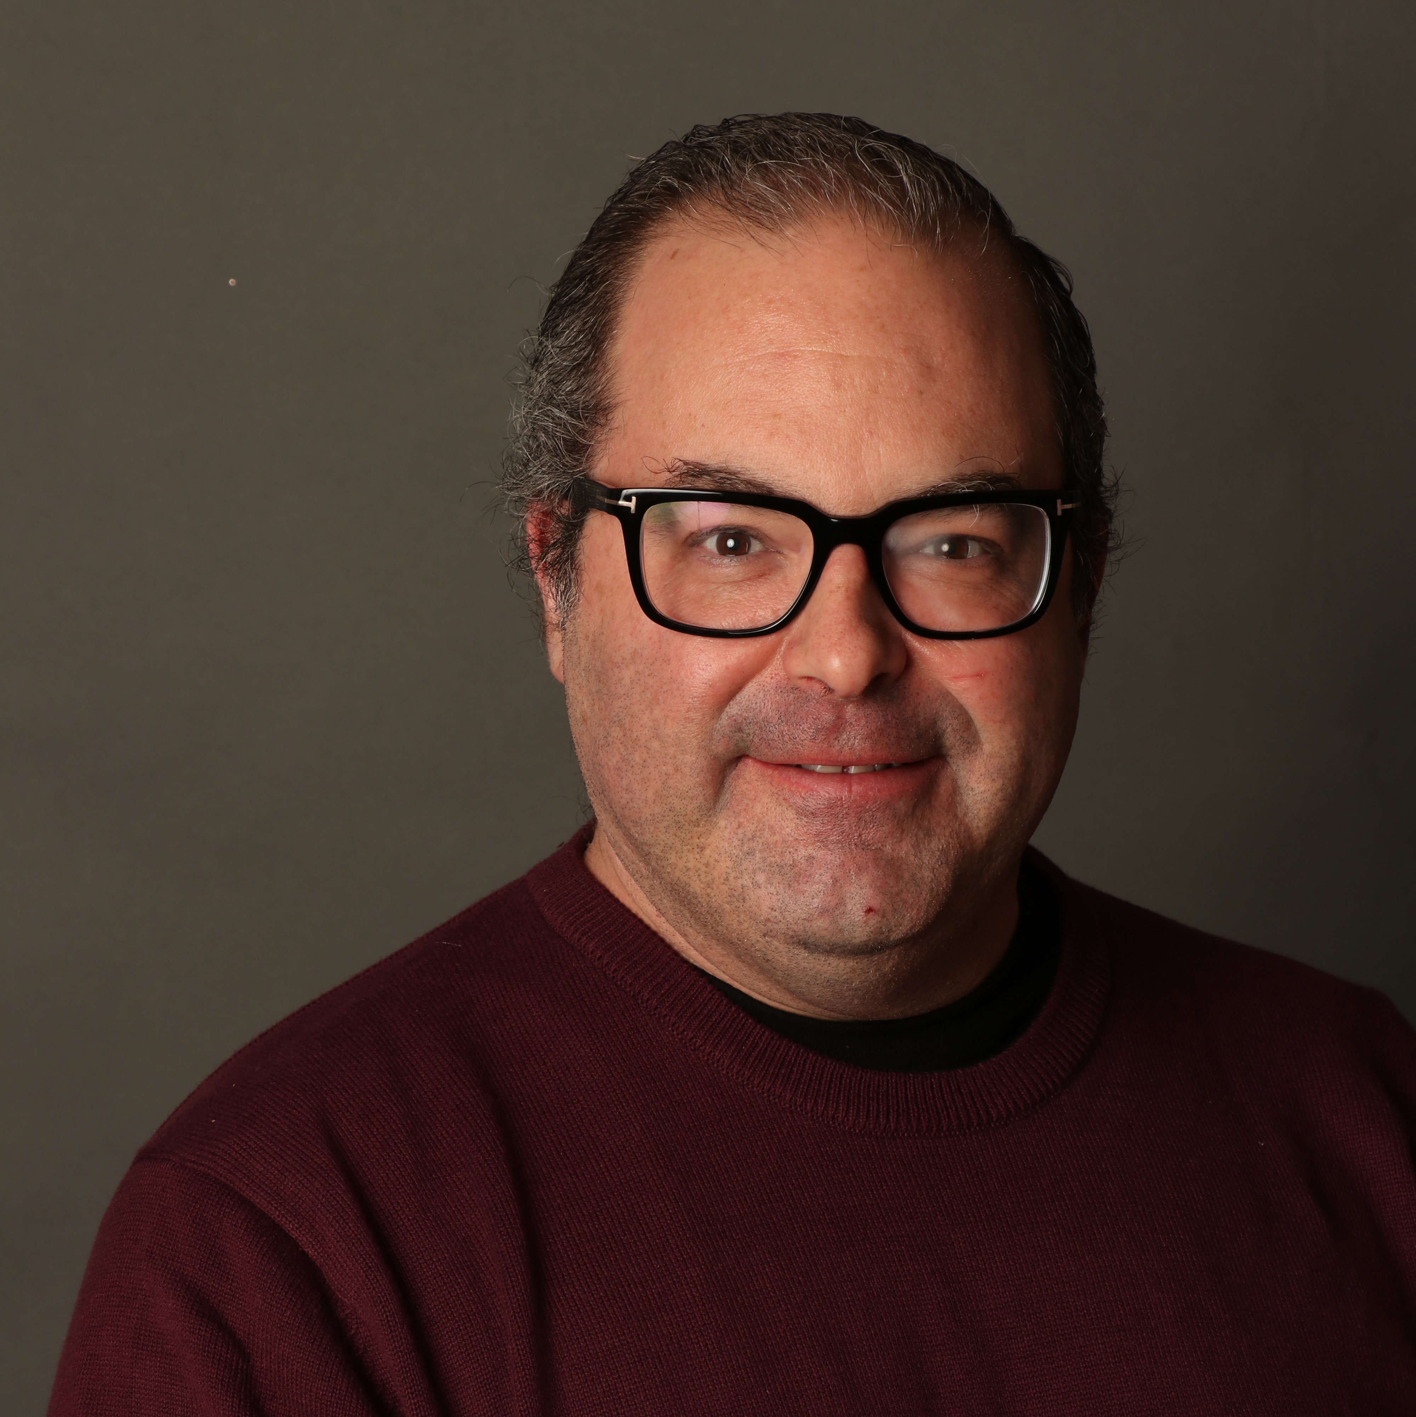
The Elements of Prompt Engineering
Tim Warner
Principal Author, Pluralsight
tim-warner@pluralsight.com

Slide 2
blah
Learning Goals

Slide 3
Session Materials
timw.info/elements

Slide 4
Break Schedule (Central time)
07:00am - Start
08:00am - Break 1 (7 min)
09:00am - Break 2 (7 min)
10:00am - Break 3 (7 min)
11:00am - Finish

Slide 5
Setting Expectations
More technical
More business

Slide 6
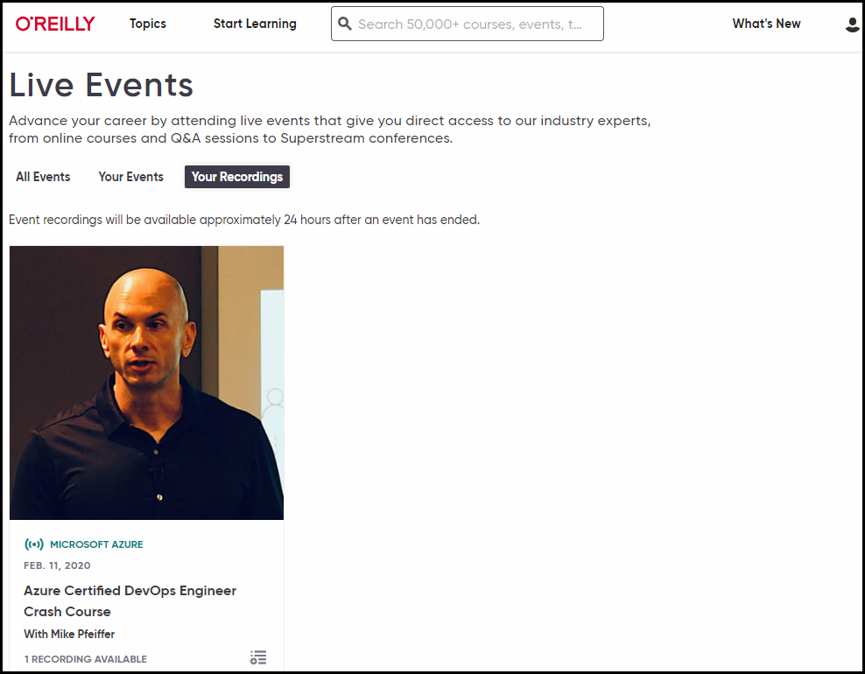
Session Recording

Slide 7
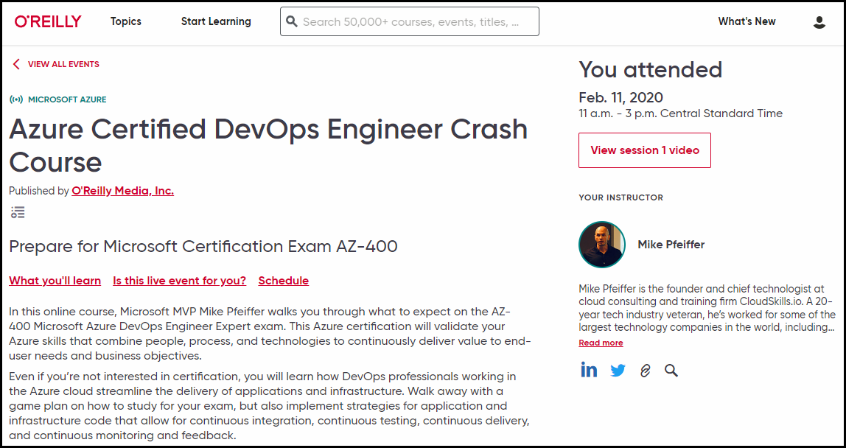
Session Recording

Slide 8

Session Recording

Slide 9


learning.oreilly.com

Slide 10



O'Reilly Native Mobile Apps

Slide 11
Foundational Terminology

Slide 12

Questions? Comments? Curiosities?

Slide 13
blah
Thanks!
Materials: timw.info/elements
LinkedIn: timw.info/li
Email: tim-warner@pluralsight.com
Summary

